Slide 1

OSINT Dashboard:
Bowser
Bryan Cruz Castillo
Cooper Van Kampen
Daniel Denekew
George Lonngren
Henry Post
Jarron Bailey
Michael Kotlyar
Rawad Alahmadi
Robert Bacius

Slide 2
Agenda
Introduction
What is Bowser
Developer Workflow
Web API for Programmers
Web interface for everyone
Data Sources
Data Analysis
Project Management Structure
Communications
Risks
Possible Future Upgrades

Slide 3


What is Bowser?
Not a turtle….

Slide 4
Why the Name Bowser?
Mary “Bowser”, Union Spy 1846-1867
Notes:
https://en.wikipedia.org/wiki/Mary_Bowser
Mary Bowser was an american former slave, and union spy during the civil war.
We chose her for our project’s name as she did spying and surveillance.
Her name is not actually Mary Bowser, but for some reason many people call her by that name.

Slide 5
Executive Summary - What is Bowser?
It is an Open Source Intelligence (OSINT) Tool that searches controversial forums and boards for issues related to domestic Terrorism.

Slide 6
Really, what is Bowser?
Bowser is a combination of a web API backend and an HTML frontend.
It allows you to gather user data from different sources and analyze it for racism, terrorism, and national security issues
We use keyword extraction to achieve this
This is a naive text analysis method
Source code located at github.com/Team-Bowser-ITMS-448/

Slide 7

Try Bowser
Try it yourself! Go to:
tinyurl.com/bowserweb for Web UI,
tinyurl.com/bowserapi for API

Slide 8

What We Scraped
4chan.org and Reddit.com
4chan Message Boards: /pol/ and /x/ main focus
/pol/ - Politically Incorrect, Offensive and harmful content
/x/ - Paranormal, Conspiracy Theories

Slide 9

Developer workflow
Git was used for source code control.
One main repository with branch protection and CI
Fork and PR workflow used to ensure all developers can develop in their own style

Slide 10

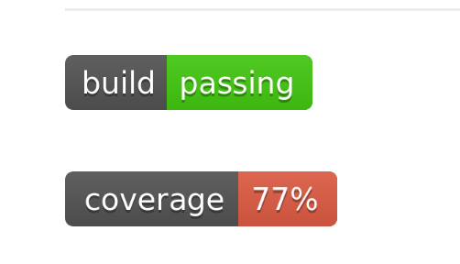
Developer CI
Used Travis CI to run Python unit tests on code prior to allowing developers to incorporate code into main branch.

Slide 11
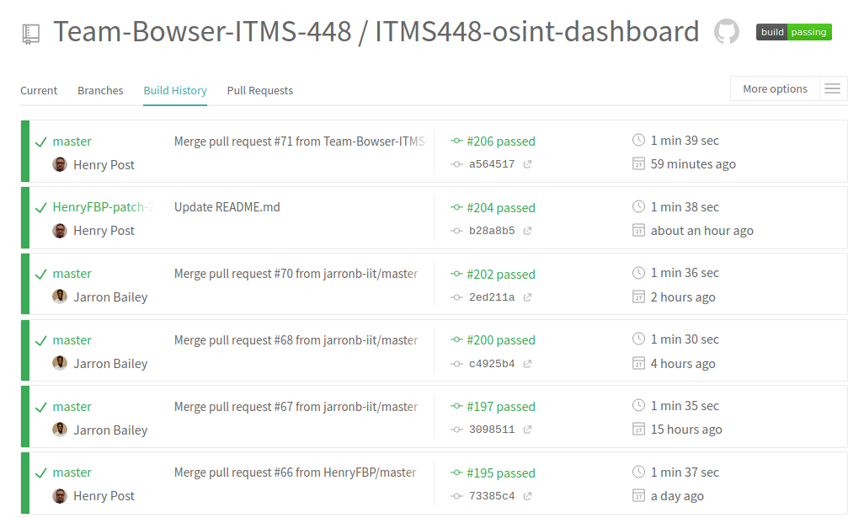
Developer workflow
Notes:
This is the build log of the team fork of the repository. It will always be ‘green’ because you are forced to pass tests before merging any code.

Slide 12
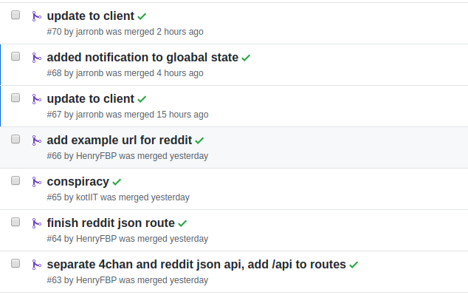
Notes:
These are the pull requests into the main branch.
They are self-contained units of work that can be seen as feature additions.
Usually, the name of the pull requests will fully describe the feature added.

Slide 13
Web API for Developers
We expose a web api that is self-documenting
It can be tested at bowser-web-app.freemyip.com:1839/api
This serves CSV files and JSON files from Reddit and 4Chan
It embeds text analysis inside of the JSON files

Slide 14
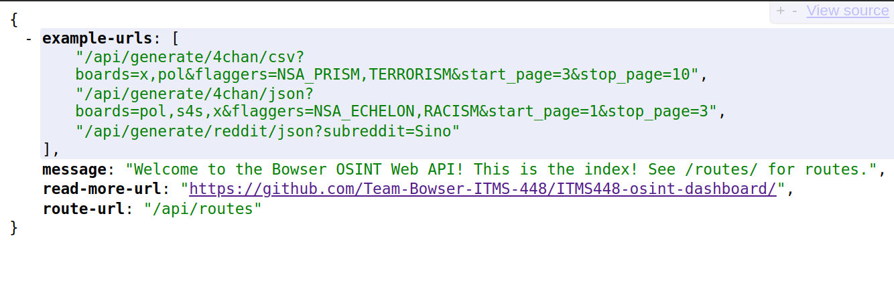
Notes:
This is what you will receive if you query /api.

Slide 15
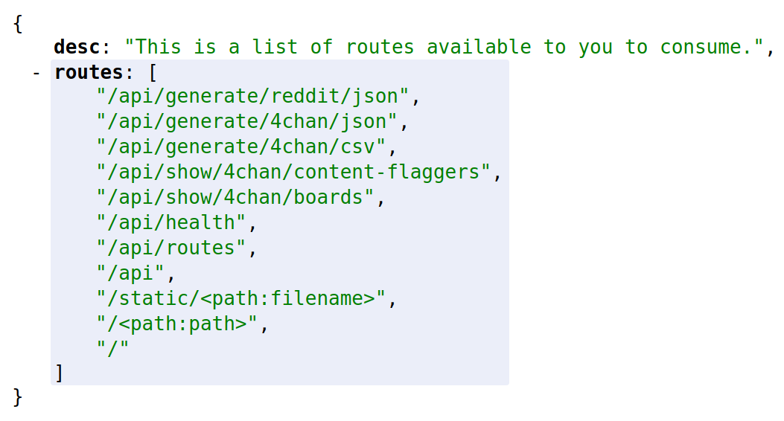
Notes:
This is a list of routes available for you to consume. All of these routes do what they appear to.

Slide 16
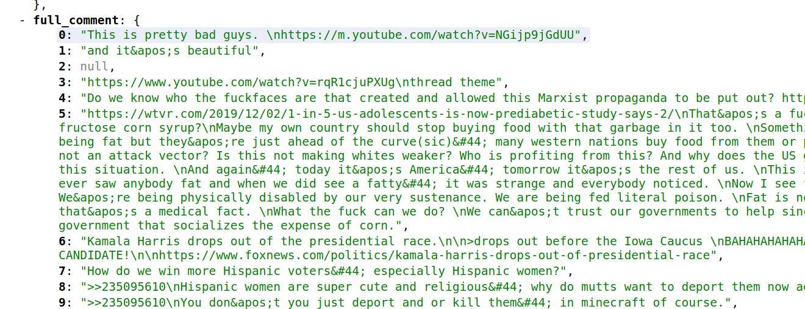
Notes:
This is a sample response from getting posts from /pol/, a politics board on 4chan.

Slide 17
Web User Interface Demo

Slide 18
Web User Interface
Built in ReactJS
Utilizing:
Material UI
Easy-Peasy for Application State Management
React Chartkick for Data Charts
Formik for Form Management
Yup, for Object Schema Validation

Slide 19
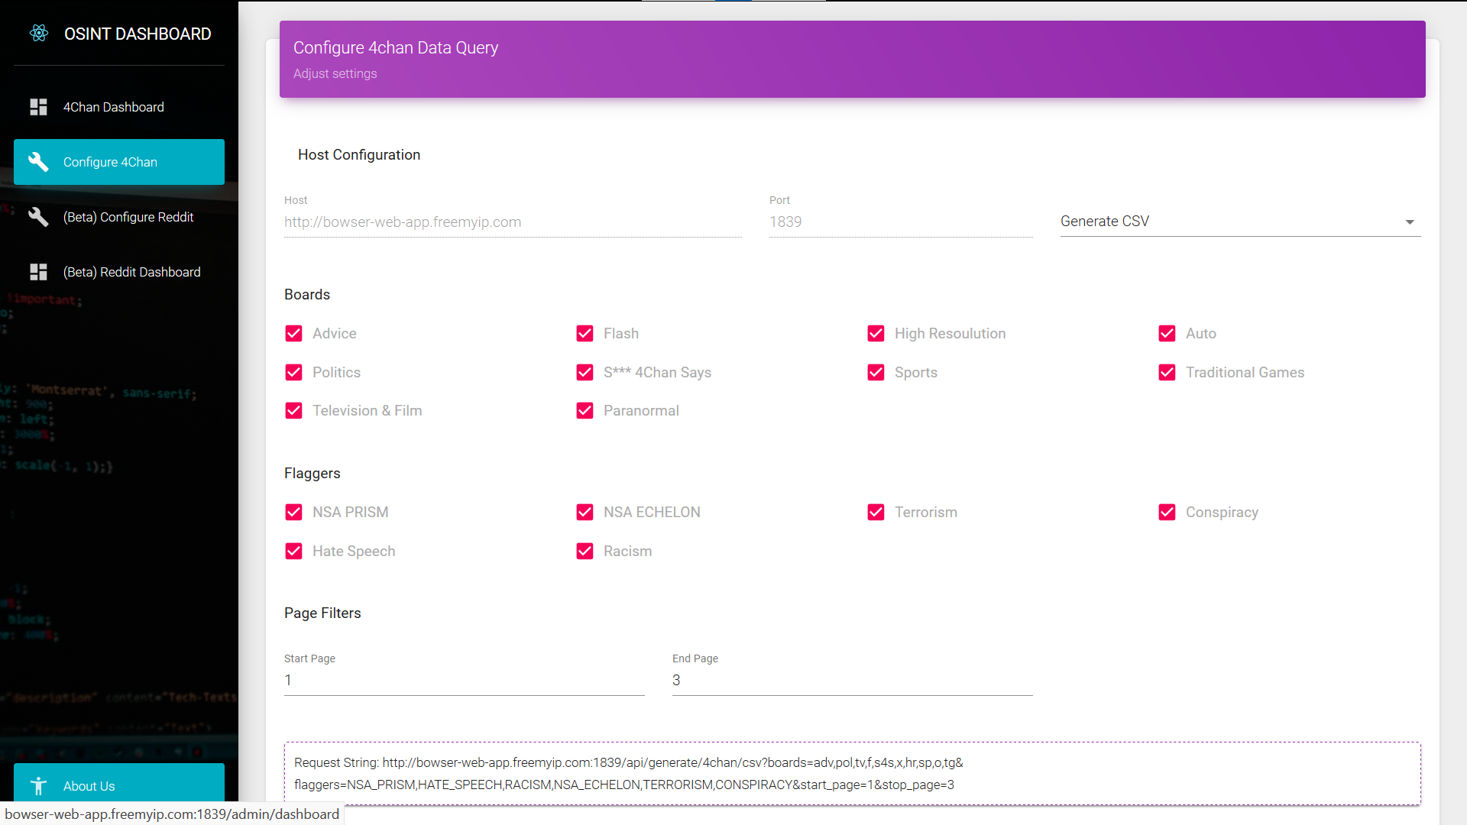
Web interface - Form Configuration

Slide 20
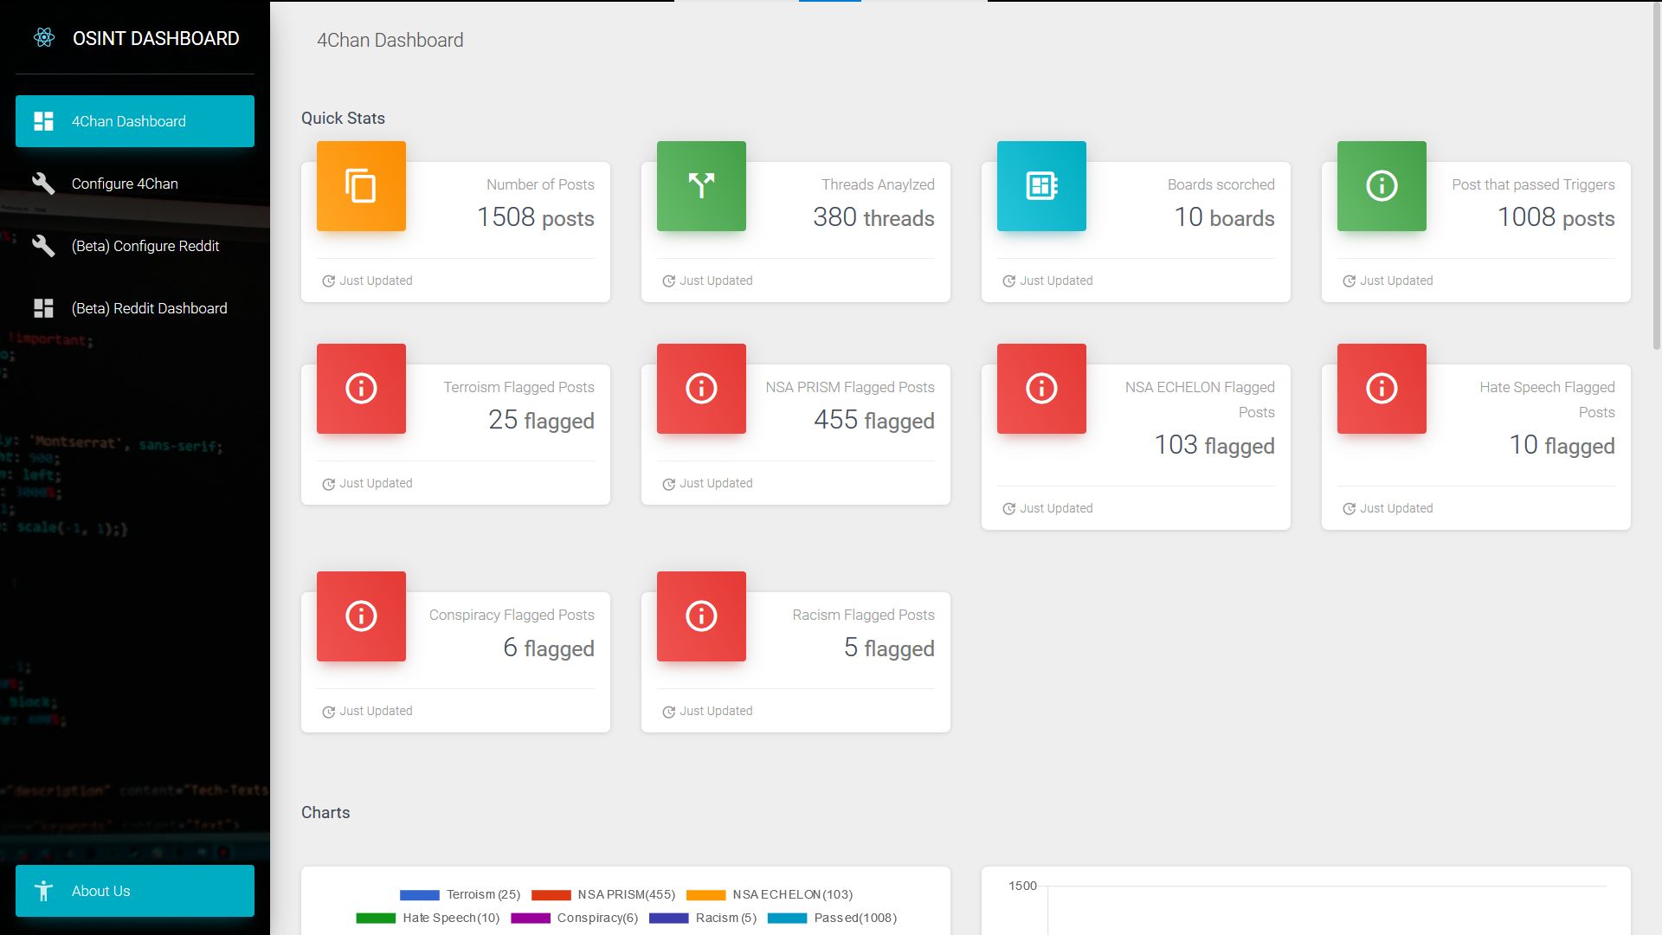
Web interface - Quick Stats

Slide 21
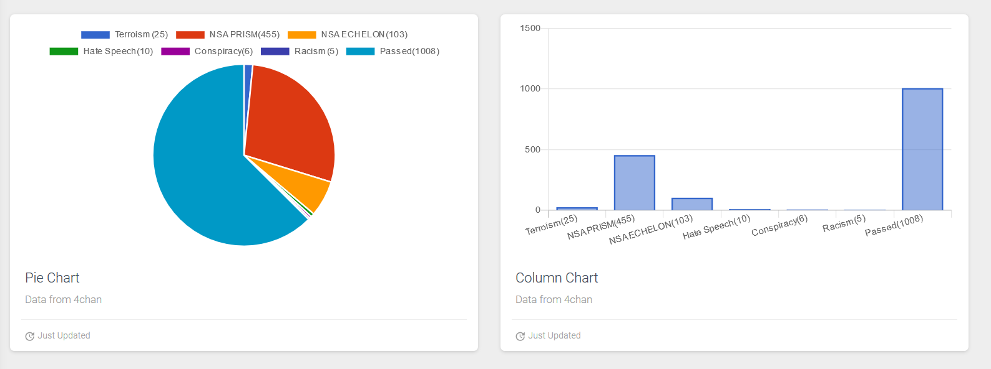
Web interface - Charts

Slide 22
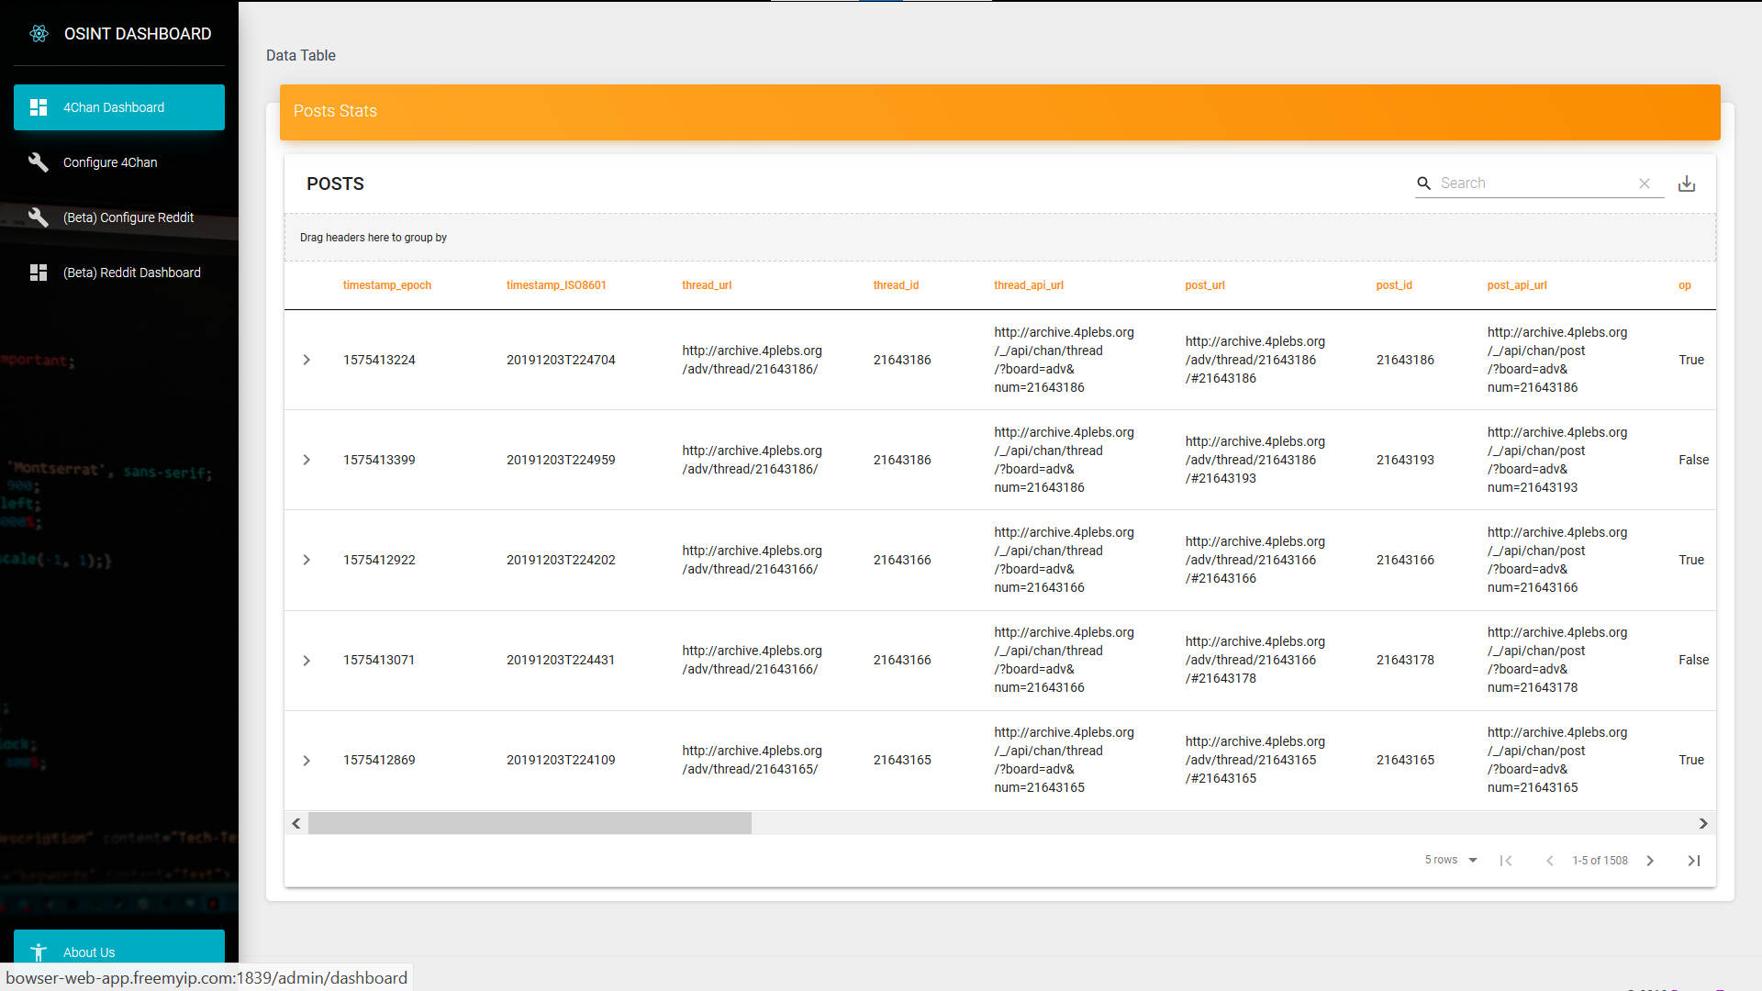
Web interface - Data Table

Slide 23
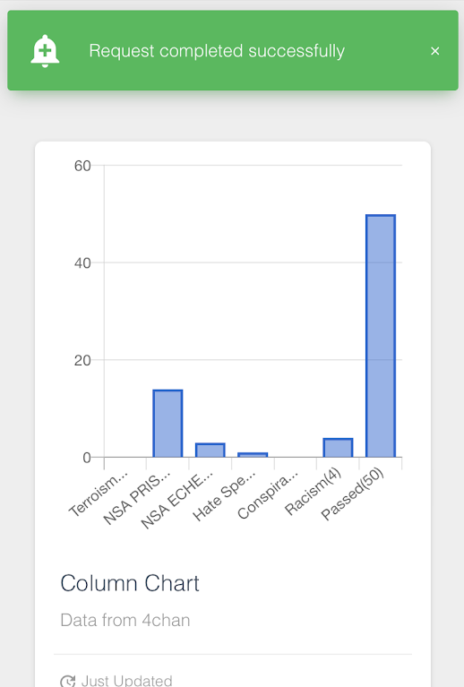
Mobile Friendly

Slide 24


Data Sources
Reddit
Very popular
Has had controversial boards before
Globally used
4chan
At times it is used to share illegal and immoral material like child sexual abuse imagery
People regularly post about the gov’t and terrorism
There have been incidents where 4chan posts have tipped authorities off to a crime

Slide 25
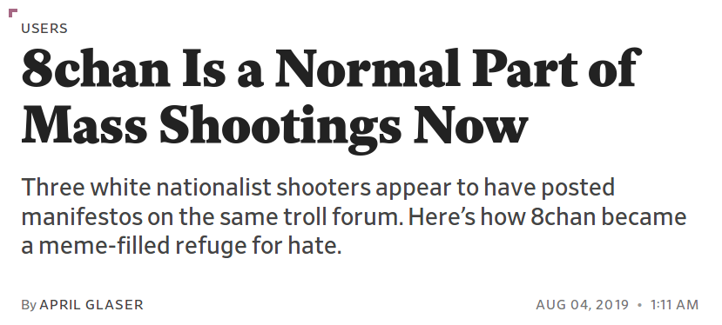
Recent events related to 4chan
QAnon Conspiracy Theory
8chan - Controversial site created from banned 4chan topics
https://slate.com/technology/2019/08/el-paso-8chan-4chan-mass-shootings-manifesto.html
8chan has been taken down from public internet (clearnet)

Slide 26

QAnon

Slide 27
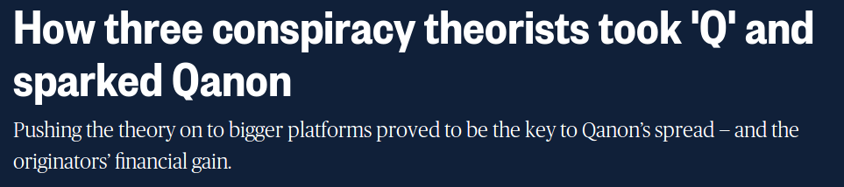
Conspiracy’s | QAnon | Pizzagate | *.gate
NBC News Story on QAnon
New Conspiracy Theory Trending
Notes:
https://www.nbcnews.com/tech/tech-news/what-qanon-guide-conspiracy-theory-taking-hold-among-trump-supporters-n897271

Slide 28
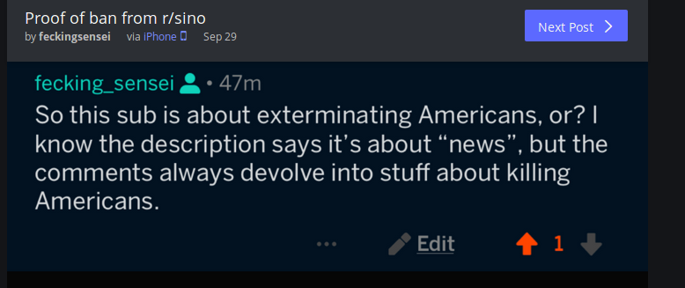
Second Source: Reddit
Currently Scraping /r/Sino
A Pro-China nationalist Subreddit
for Westerners in the US/CA.
Users mentioning America
get banned

Slide 29
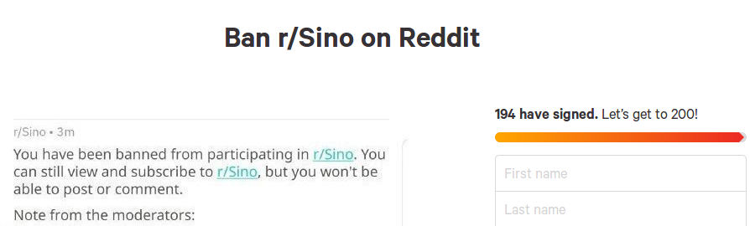
Recent Events Related to /r/Sino
USA v China Trade War
Chinese Espionage in the US
Petition on Change.Org to ban the subreddit

Slide 30
Data Analysis
Most people are from the US who go on 4chan
We are not sure if people use VPNs to route through US
We cannot keep track of individual users (No ID)

Slide 31
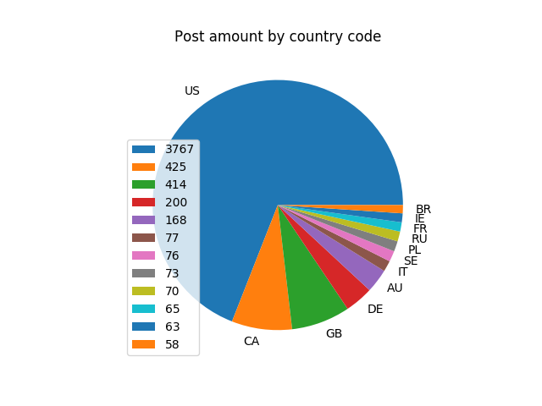
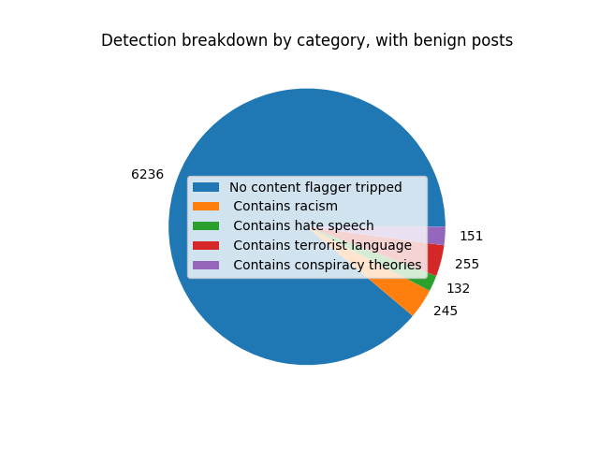
Data Analysis Example
Categorize Data by Location
Category breakdown by location

Slide 32
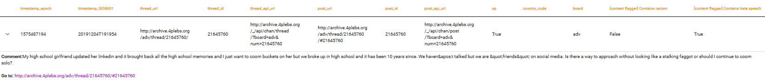
Data Analysis Errors
False Positives (Type 1 Error): Null hypothesis is true, but rejected
Few instances during data parsing that the system returns a false negative.
Type 1 triggers: Users that utilize flagged keywords in reference to themselves. Keywords can hold a different connotations.

Slide 33
Data Analysis Errors (Cont.)
False Negatives (Type 2 Error): Null hypothesis is false, but fails to be rejected
Frequency cannot be determined. We have to physically read all thread comments to find missed flags.
Type 2 triggers: Misspelling of keywords flags, new slang/terms not in library, words utilized by small knit communities.

Slide 34
Data Analysis Error Future Fix Implementation
Type 1 Errors:
Ignore strings of words that contain self reference
Type 2 Errors:
Update Flagged Keywords Dictionary with new terms
Keep a library of dictionary terms with different variations they may appear as.
Ex.) Usage of symbols and numbers in flagged words

Slide 35
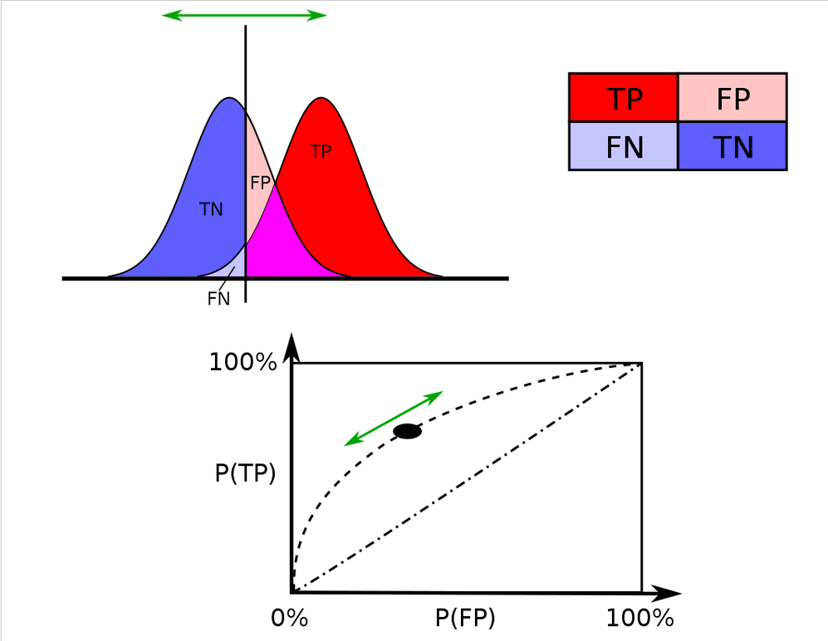
Data Analysis Errors
We rather have more False Negatives than False Positives
Minimize the amount of “garbage” data being returned
A threshold can make the data more specific or more sensitive, but risk factor will decrease/increases.

Slide 36
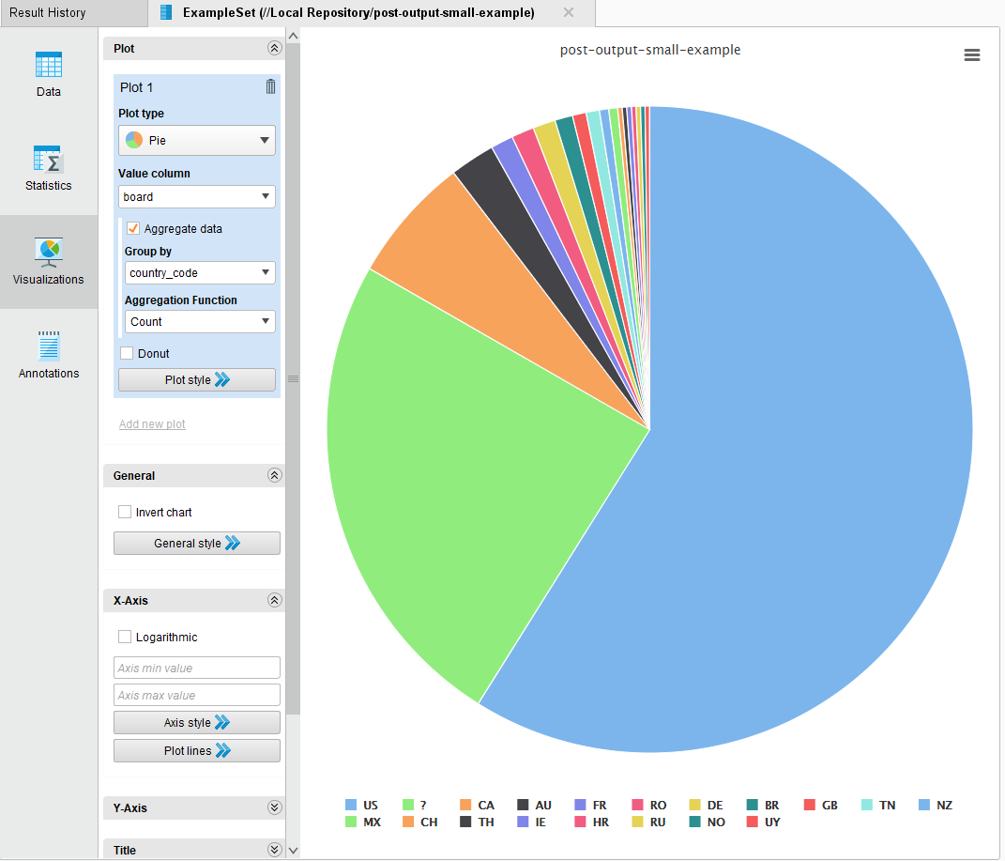
Flaggers /country

Slide 37
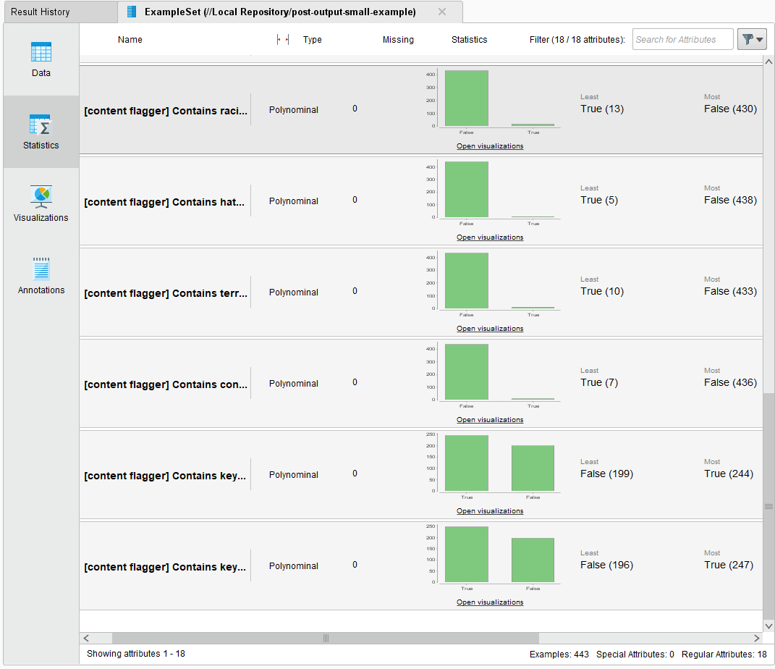
RapidMiner data outcome

Slide 38
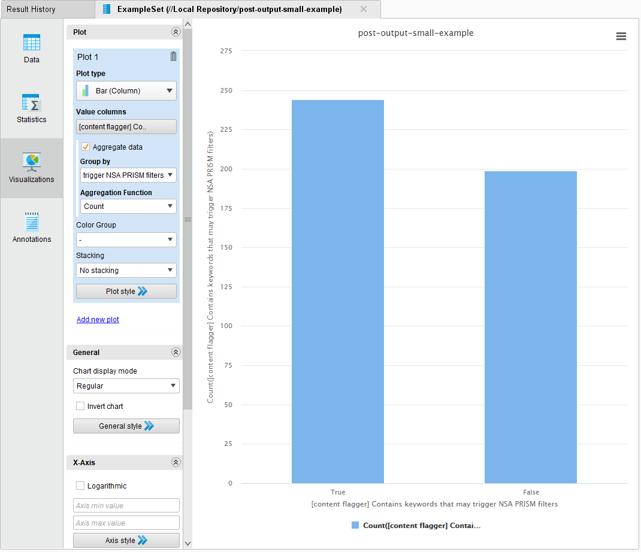
RapidMiner Outcome Cont / content flagger

Slide 39
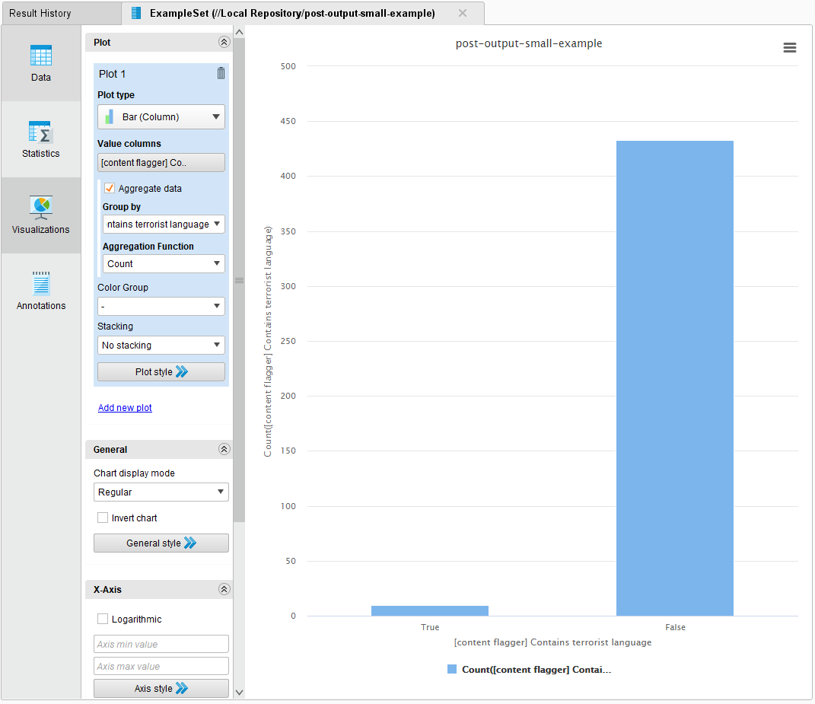
Content /flagger

Slide 40
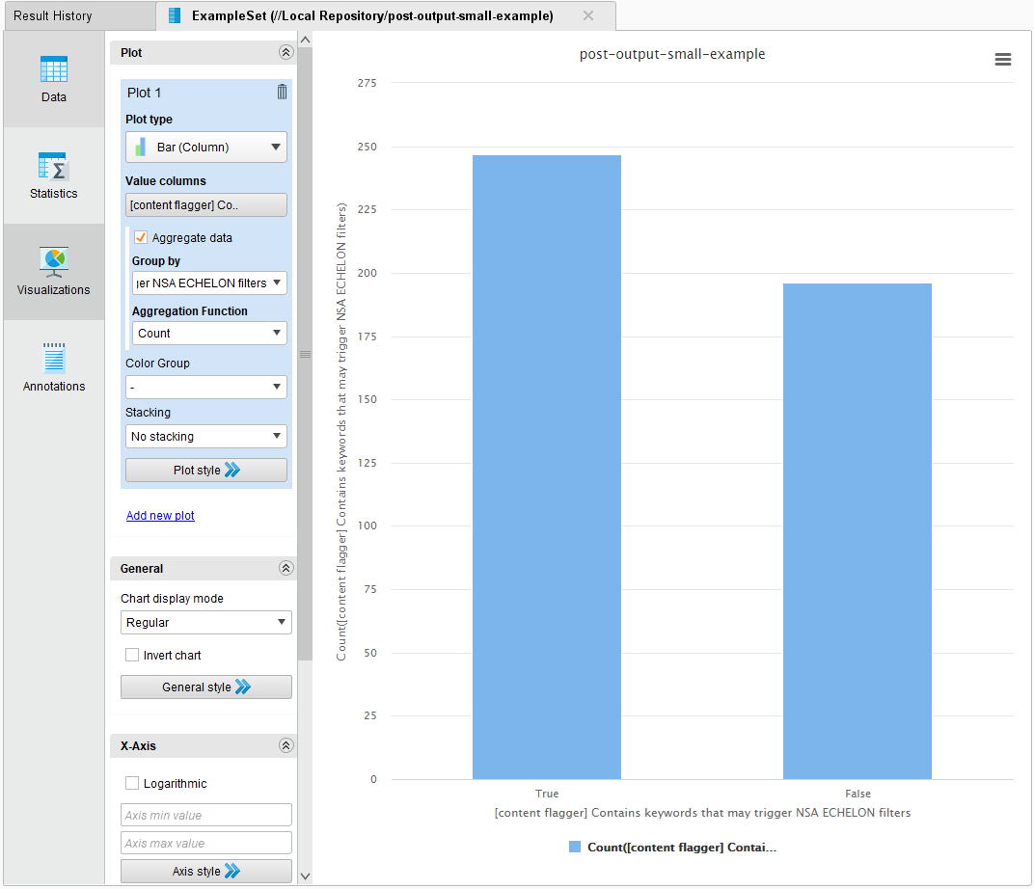
Flagger Cont...

Slide 41
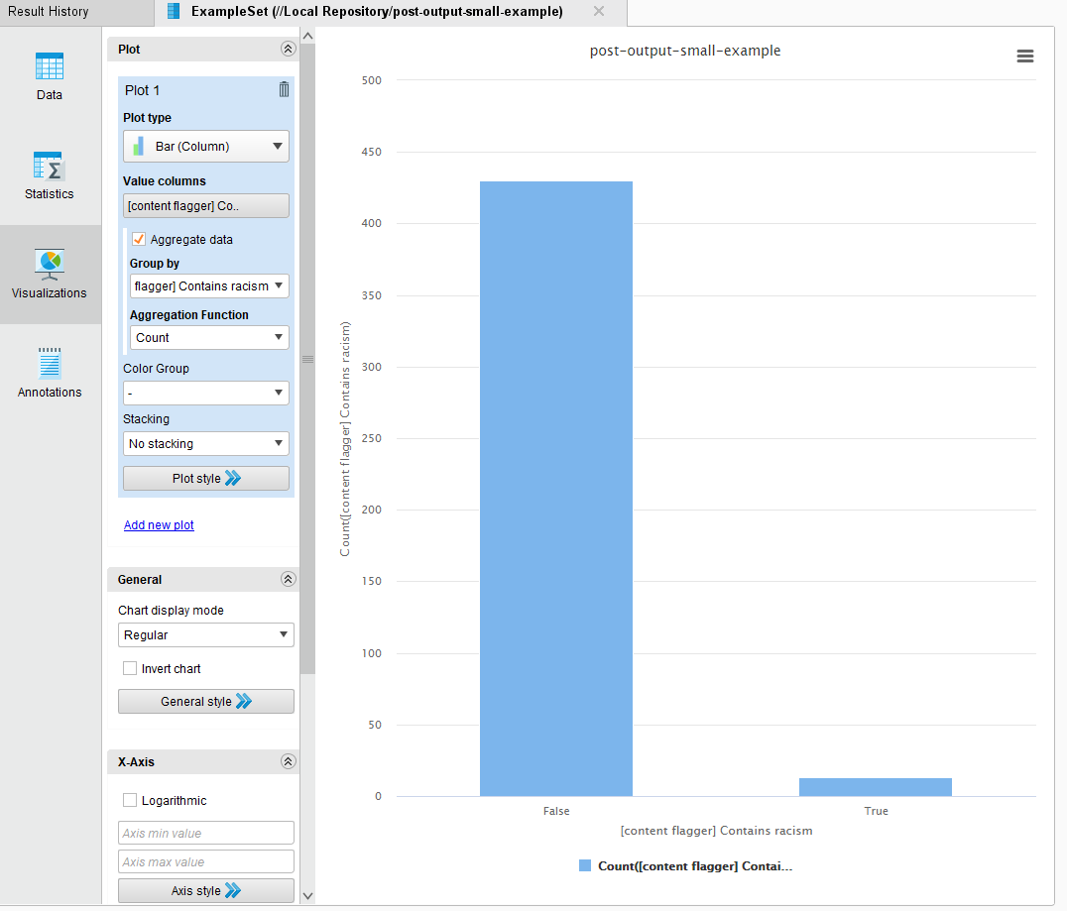
Flagger cont...

Slide 42
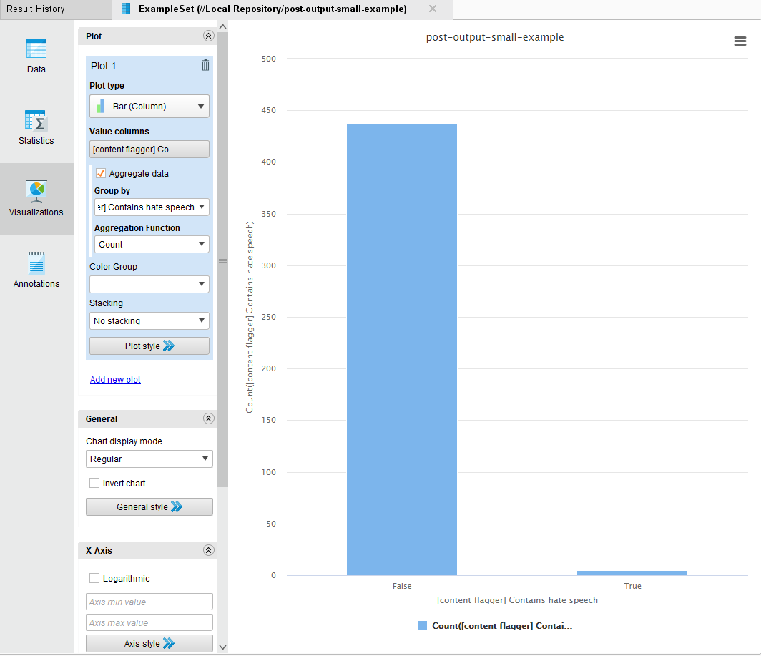
Flagger cont...

Slide 43
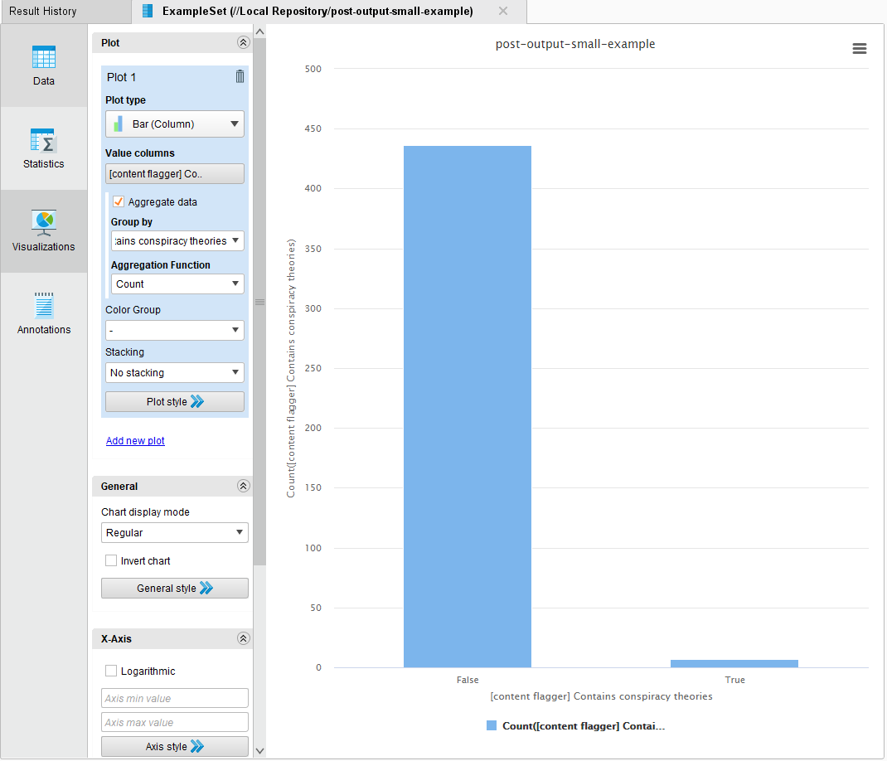
Flagger /Content

Slide 44
Debugging / Analysis
Testing of Formatting and Scraping done on Various platforms.
Testing Scraper Migration from local machines to Public Web
Used small sample CSV to for migration testing

Slide 45

Debugging / Analysis
Used python Pandas to search through flagged content
Found 8kun board in DarkWeb
4chan limits metadata collection
IP Address, Platform, Geo-location, user agent.
Unsure if VPN is used

Slide 46
Threat Keyword Process
We started testing with various broad keywords surrounding the topics of terrorism, hate speech, racism, and conspiracies
After further data analysis, we tweaked our keywords for our terrorism category to resemble The Department of Homeland Securities terrorism keyword searches seen in the below link (Page 23)
https://epic.org/foia/epic-v-dhs-media-monitoring/Analyst-Desktop-Binder-REDACTED.pdf
As for our other topics (hate speech, racism, conspiracies) we added on, removed, and renamed keywords to better data after testing iterations

Slide 47
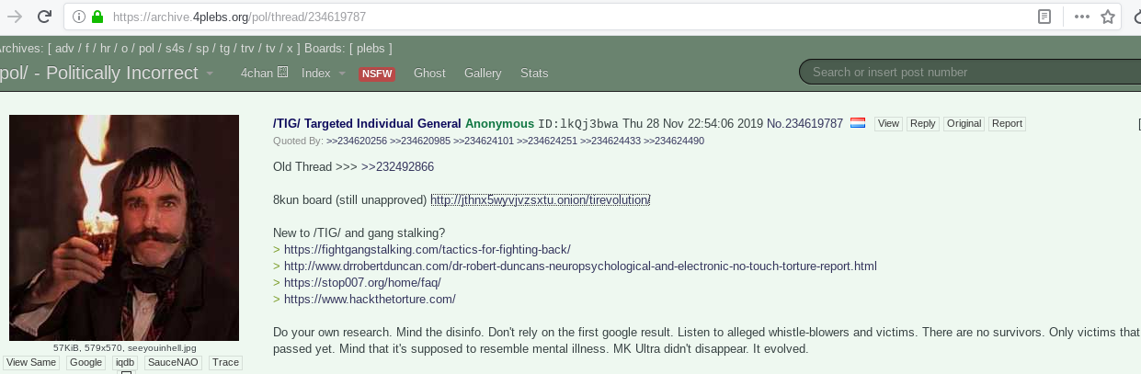
Flagged Content with .onion link

Slide 48
Result
Board Request Pending for Approval
As of Dec 2, Link no longer Works

Slide 49
Project Management Structure
Work Breakdown
Project Management Team
Developer Team
Analysis Team

Slide 50
Project Management Structure
Project Stages
Project Kick-off (Assign Roles and Teams, Set Goals, Scope)
Code Development
Training, Testing, Analysis, Further Development
Project Completion (Final Meetings, Presentation)

Slide 51



Communications
Main Communication via Google Hangouts
A Dedicated Google Drive
GitHub
Travis

Slide 52
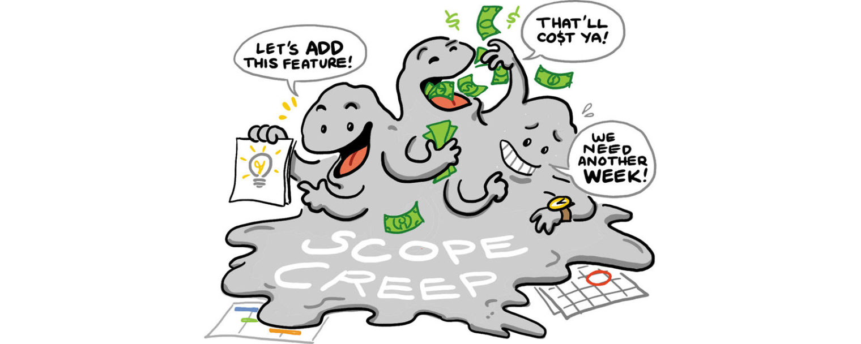
Risks
Not being able to finish within the allotted time
Content flagger might generate false positives
4Plebs blocks AWS IP addresses
Heroku uses AWS IPs
We were forced to change hosting from Heroku to DigitalOcean
IP address may change
A cron job updates the IP address every hour

Slide 53
Risks Continued
Merge conflicts
TOR sites found
Unable to scrape contents of “.onion” sites
Getting on a Watchlist or Blacklist
Flagged Content may contain something illegal

Slide 54
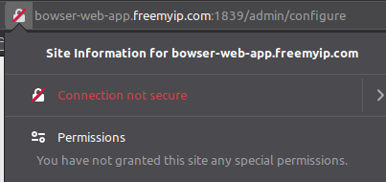
Using HTTP
Currently site does not use
https

Slide 55

Future Work

Slide 56
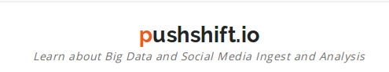
Future Work: Web Interface
More data sources
Can use pushshift.io, a reddit data gathering tool
Simplify quarantined subreddits.
Creating a more maintainable frontend codebase

Slide 57
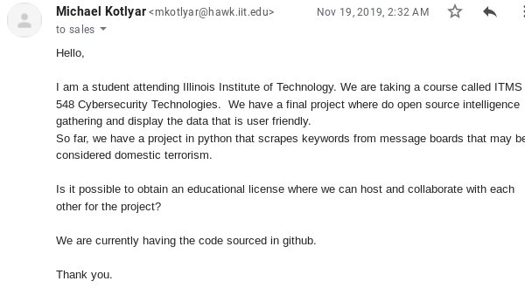
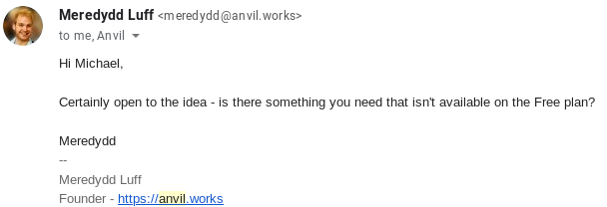
Anvil.Works
Full stack python dev

Slide 58
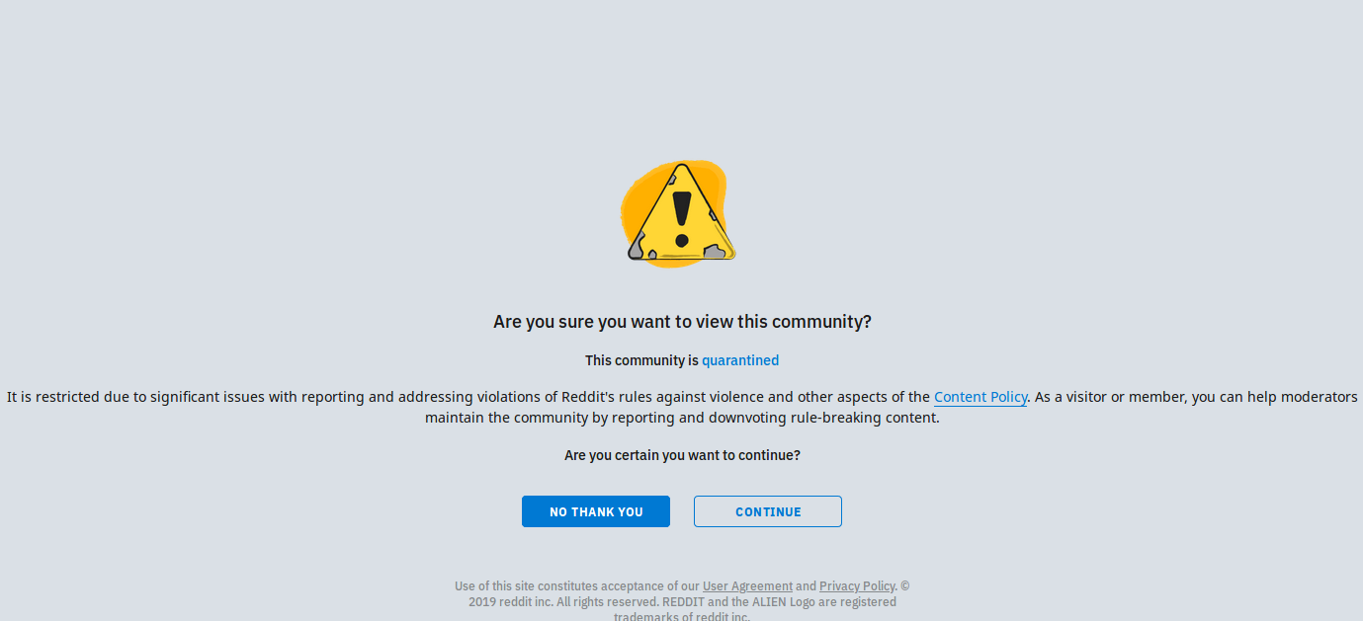
r/The_Donald

Slide 59
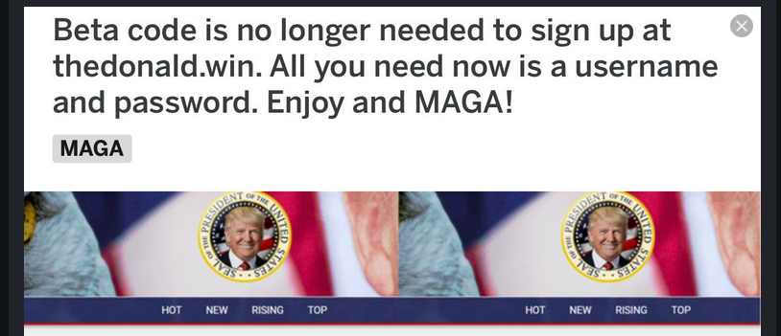
Future Work: thedonald.win
Reddit quarantines Trump subreddit r/The_Donald for violent comments
Trump supporters create social media platform tailored for them

Slide 60
Future Work: Web API Backend
More data sources
Unified data analysis framework
Expose this via the web API
Allow users to provide their own custom analysis rules
Unified ‘generic post’ framework
Combine Facebook, Reddit, Twitter data sources into one format that is universal

Slide 61
Future Work: API Backend
Implement a scalable method of modifying our content flagger database.
Potentially use existing datasets (‘big data’) to find more keywords
Implement Machine Learning / AI to populate and create new filters

Slide 62
Future Work: Web API Backend
There is no authentication on the Web API
This is a security problem
Our server can be hijacked to send a lot of queries to Reddit or 4Plebs
Find other Reddit or imageboard APIs to use
This cuts down on the code that we must create
It also makes us more dependent on other code, which has its own caveats

Slide 63

Future Work: The Tor network
Create a wiki of flagged content redirecting to .onion sites
Scrape .onion sites and the Dark Web
Find which Public boards have Dark Web boards
Find the where most-used 8kun is hosted

Slide 64
Future Work: Community and Funding
Leverage Github for feedback, problems, future requests, and contribution. It is Open Source.
Implement a Donation Page for Web Hosting, official Domain, Blockchain Implementation. IPFS/I2P/other peer-to-peer network implementation

Slide 65
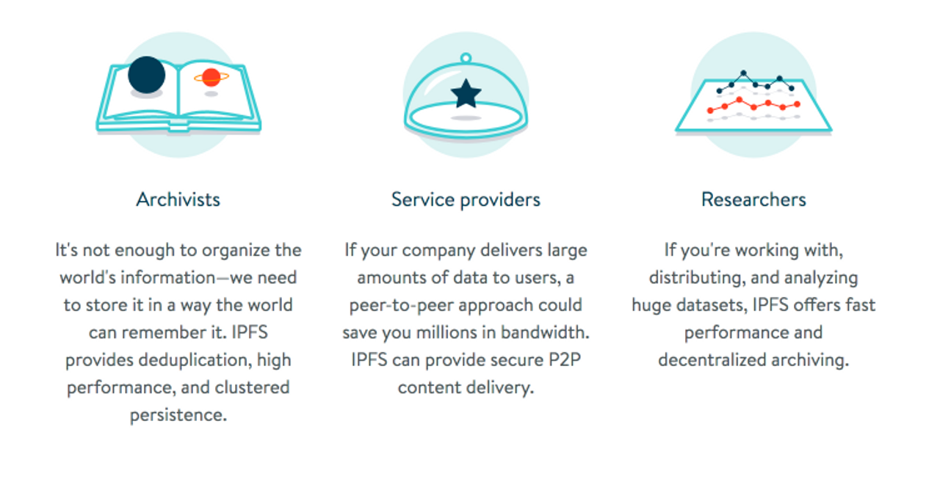
InterPlanetary File System (IPFS ) - P2P browser
https://ipfs.io/

Slide 66
Future - Angel Investor / Licensing
Partner with the government to integrate or further develop our tool
Find private corporate security companies to licence the data to
Apply an Analyst Model to increase data quality
Add more data sources to ingest large amounts of data to analyze (such as Twitter)

Slide 67
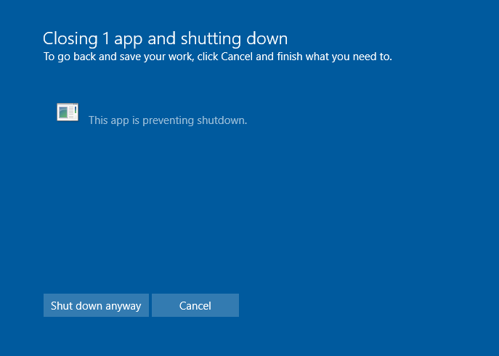
Thank you! Questions?
bowser.ppt

